Slide 1
一些点源分析

Slide 2
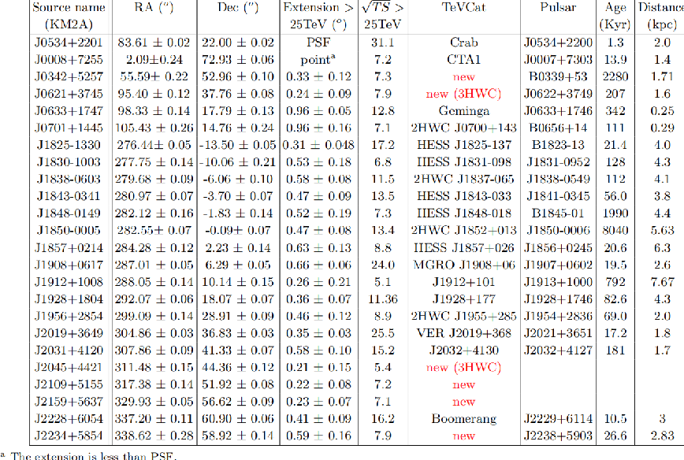

Slide 3
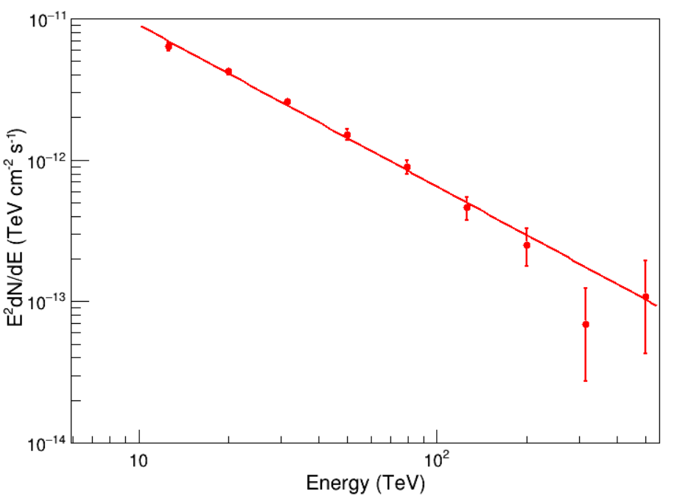

J0534+2201
Double_t Non[bin] = {19193, 4555, 517, 167, 93, 31, 11, 2, 2};
Double_t Noff[bin] = {17093.199, 3416.6721, 149.05238, 18.126911, 8.0095165, 1.2181522, 0.2922795, 0.0743711, 0.0329984};
ra:83.61 dec:22.00
E:12.6 flux:4.03e-14 + 2.66e-15 - 2.66e-15
E:20.0 flux:1.07e-14 + 6.32e-16 - 6.32e-16
E:31.6 flux:2.59e-15 + 1.60e-16 - 1.60e-16
E:50.1 flux:6.07e-16 + 5.27e-17 - 5.27e-17
E:79.4 flux:1.42e-16 + 1.62e-17 - 1.62e-17
E:125.9 flux:2.92e-17 + 5.46e-18 - 5.46e-18
E:199.5 flux:6.27e-18 + 2.03e-18 - 1.84e-18
E:316.2 flux:6.87e-19 + 5.56e-19 - 4.15e-19
E:501.2 flux:4.29e-19 + 3.44e-19 - 2.58e-19
Epoint: 20
alpha:1.02648e-14 (+-)3.38677e-16
beta:-3.1436 (+-)0.0404621
$$f\left(E\right)=\left(1.026±0.0338\right)×{10}^{−14}∙{\left(\frac{E}{20TeV}\right)}^{−3.1436±0.0404}$$

Slide 4
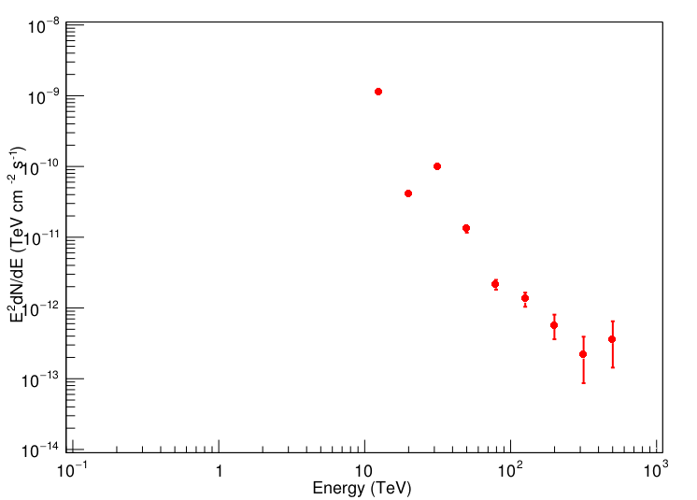

J0008+7255
Double_t Non[bin] = {283, 1150, 36, 14, 28, 6, 1, 0, 0, 0};
Double_t Noff[bin] = {295.92675, 1185.4459, 36.413193, 12.619525, 12.109032, 1.0193336, 0.1607213, 0.0385364, 0.0089900, 0.0091603};
ra:2.09 dec:72.93
E:12.6 flux:5.24e-12 + 4.76e-13 - 4.76e-13
E:20.0 flux:5.84e-14 + 4.82e-15 - 4.82e-15
E:31.6 flux:4.94e-14 + 4.09e-15 - 4.09e-15
E:50.1 flux:2.76e-15 + 3.22e-16 - 3.22e-16
E:79.4 flux:1.85e-16 + 2.91e-17 - 2.91e-17
E:125.9 flux:4.63e-17 + 1.05e-17 - 1.05e-17
E:199.5 flux:8.05e-18 + 3.33e-18 - 2.93e-18
E:316.2 flux:1.27e-18 + 1.02e-18 - 7.64e-19
E:501.2 flux:8.65e-19 + 6.94e-19 - 5.20e-19
E:794.3 flux:2.07e-19 + 2.18e-19 - 1.42e-19
Epoint: 20
alpha:6.86247e-14 (+-)3.82496e-15
beta:-4.04023 (+-)0.075332
$$f\left(E\right)=\left(6.86±0.382\right)×{10}^{−14}∙{\left(\frac{E}{10TeV}\right)}^{−4.04±0.075}$$

Slide 5
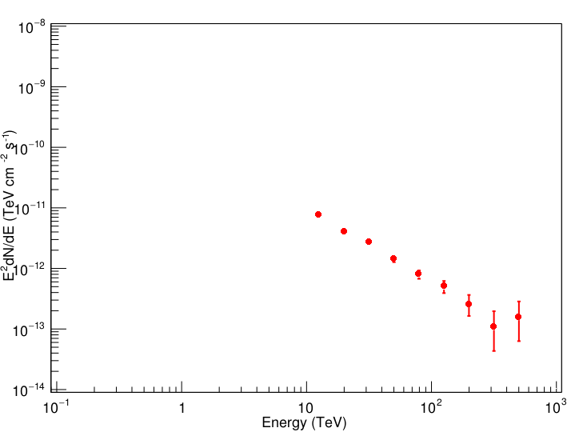

J0342+5257
ra:55.59 dec:52.96
E:12.6 flux:4.81e-14 + 4.38e-15 - 4.38e-15
E:20.0 flux:1.01e-14 + 8.36e-16 - 8.36e-16
E:31.6 flux:2.72e-15 + 2.25e-16 - 2.25e-16
E:50.1 flux:5.73e-16 + 6.68e-17 - 6.68e-17
E:79.4 flux:1.27e-16 + 1.99e-17 - 1.99e-17
E:125.9 flux:3.19e-17 + 7.23e-18 - 7.23e-18
E:199.5 flux:6.49e-18 + 2.68e-18 - 2.36e-18
E:316.2 flux:1.09e-18 + 8.76e-19 - 6.56e-19
E:501.2 flux:6.29e-19 + 5.05e-19 - 3.78e-19
E:25118.9 flux:2.73e-24 + 2.88e-24 - 1.87e-24
Epoint: 20
alpha:1.13e-14 (+-)4.91407e-16
beta:-3.09 (+-)0.0597589
$$f\left(E\right)=\left(1.13±0.049\right)×{10}^{−14}∙{\left(\frac{E}{10TeV}\right)}^{−3.09±0.0598}$$

Slide 6


J0621+3745
ra:95.40 dec:37.76
E:12.6 flux:3.16e-14 + 2.88e-15 - 2.88e-15
E:20.0 flux:8.16e-15 + 6.73e-16 - 6.73e-16
E:31.6 flux:2.05e-15 + 1.70e-16 - 1.70e-16
E:50.1 flux:4.77e-16 + 5.57e-17 - 5.57e-17
E:79.4 flux:1.03e-16 + 1.62e-17 - 1.62e-17
E:125.9 flux:2.84e-17 + 6.43e-18 - 6.43e-18
E:199.5 flux:5.67e-18 + 2.34e-18 - 2.07e-18
E:316.2 flux:1.02e-18 + 8.23e-19 - 6.17e-19
E:501.2 flux:5.95e-19 + 4.77e-19 - 3.58e-19
E:25118.9 flux:2.59e-24 + 2.73e-24 - 1.77e-24
Epoint: 20
alpha:1.13e-14 (+-)3.65823e-16
beta:-3.09 (+-)0.0568178
$$f\left(E\right)=\left(1.13±0.0366\right)×{10}^{−14}∙{\left(\frac{E}{10TeV}\right)}^{−3.09±0.0568}$$

Slide 7
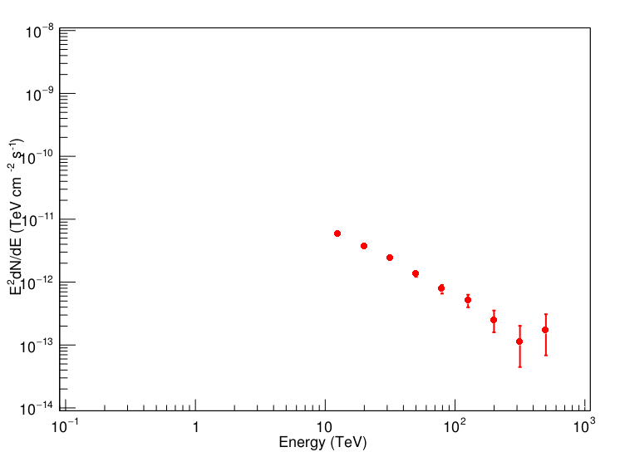

J0633+1747
ra:98.33 dec:17.79
E:12.6 flux:3.70e-14 + 3.36e-15 - 3.36e-15
E:20.0 flux:9.35e-15 + 7.72e-16 - 7.72e-16
E:31.6 flux:2.38e-15 + 1.98e-16 - 1.98e-16
E:50.1 flux:5.47e-16 + 6.38e-17 - 6.38e-17
E:79.4 flux:1.24e-16 + 1.94e-17 - 1.94e-17
E:125.9 flux:3.24e-17 + 7.34e-18 - 7.34e-18
E:199.5 flux:6.29e-18 + 2.60e-18 - 2.29e-18
E:316.2 flux:1.12e-18 + 9.02e-19 - 6.75e-19
E:501.2 flux:6.82e-19 + 5.47e-19 - 4.10e-19
E:25118.9 flux:2.59e-24 + 2.73e-24 - 1.77e-24
alpha:1.13e-14 (+-)4.24197e-16
beta:-3.09 (+-)0.056658
$$f\left(E\right)=\left(1.13±0.0424\right)×{10}^{−14}∙{\left(\frac{E}{10TeV}\right)}^{−3.09±0.0567}$$

Slide 8
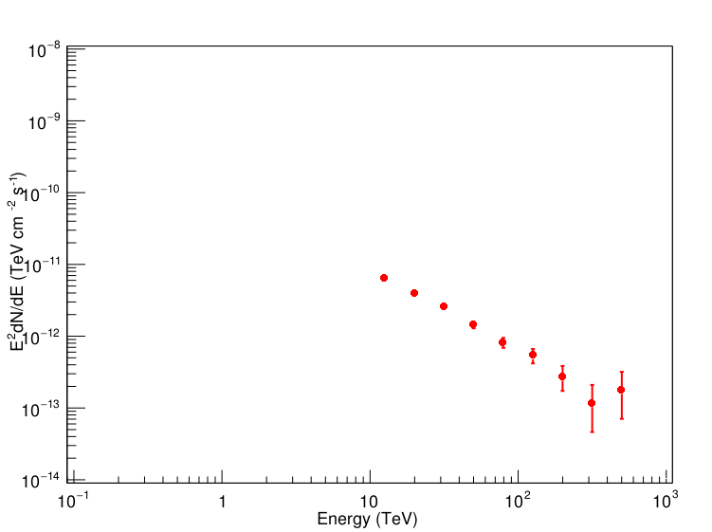

J0701+1445
ra:105.43 dec:14.76
E:12.6 flux:4.05e-14 + 3.68e-15 - 3.68e-15
E:20.0 flux:9.93e-15 + 8.20e-16 - 8.20e-16
E:31.6 flux:2.55e-15 + 2.12e-16 - 2.12e-16
E:50.1 flux:5.81e-16 + 6.78e-17 - 6.78e-17
E:79.4 flux:1.30e-16 + 2.04e-17 - 2.04e-17
E:125.9 flux:3.41e-17 + 7.72e-18 - 7.72e-18
E:199.5 flux:6.83e-18 + 2.82e-18 - 2.49e-18
E:316.2 flux:1.16e-18 + 9.34e-19 - 7.00e-19
E:501.2 flux:7.05e-19 + 5.65e-19 - 4.24e-19
E:25118.9 flux:3.03e-24 + 3.20e-24 - 2.08e-24
alpha:1.13e-14 (+-)4.56467e-16
beta:-3.09 (+-)0.0572139
$$f\left(E\right)=\left(1.13±0.0456\right)×{10}^{−14}∙{\left(\frac{E}{10TeV}\right)}^{−3.09±0.0572}$$

Slide 9
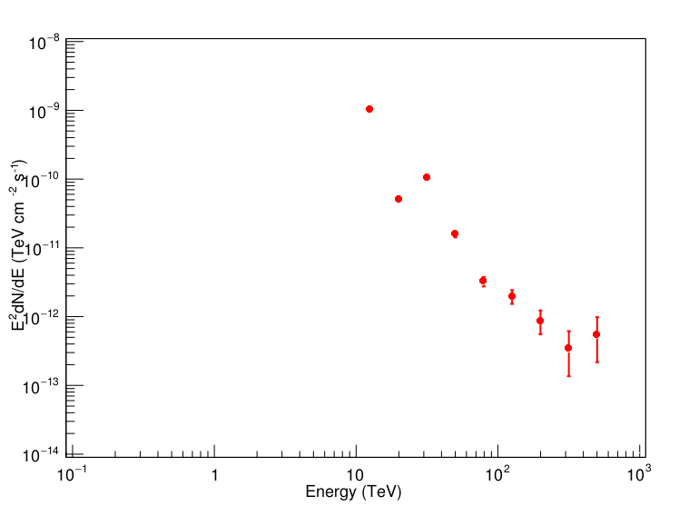

J1830-1330
ra:276.44 dec:-13.50
E:12.6 flux:6.58e-12 + 5.98e-13 - 5.98e-13
E:20.0 flux:1.29e-13 + 1.06e-14 - 1.06e-14
E:31.6 flux:1.07e-13 + 8.84e-15 - 8.84e-15
E:50.1 flux:6.40e-15 + 7.47e-16 - 7.47e-16
E:79.4 flux:5.16e-16 + 8.12e-17 - 8.12e-17
E:125.9 flux:1.25e-16 + 2.83e-17 - 2.83e-17
E:199.5 flux:2.19e-17 + 9.05e-18 - 7.98e-18
E:316.2 flux:3.42e-18 + 2.75e-18 - 2.06e-18
E:501.2 flux:2.17e-18 + 1.74e-18 - 1.30e-18
E:25118.9 flux:8.16e-24 + 8.60e-24 - 5.59e-24
alpha:1.13e-14 (+-)7.00165e-15
beta:-3.09 (+-)0.0768314
$$f\left(E\right)=\left(1.13±0.7002\right)×{10}^{−14}∙{\left(\frac{E}{10TeV}\right)}^{−3.09±0.0768}$$

Slide 10
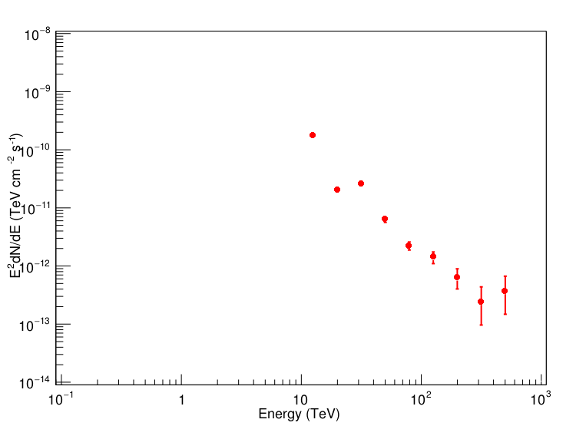

J1825-1003
ra:277.75 dec:-10.06
E:12.6 flux:1.10e-12 + 1.00e-13 - 1.00e-13
E:20.0 flux:5.05e-14 + 4.17e-15 - 4.17e-15
E:31.6 flux:2.63e-14 + 2.18e-15 - 2.18e-15
E:50.1 flux:2.53e-15 + 2.96e-16 - 2.96e-16
E:79.4 flux:3.54e-16 + 5.57e-17 - 5.57e-17
E:125.9 flux:8.96e-17 + 2.03e-17 - 2.03e-17
E:199.5 flux:1.59e-17 + 6.57e-18 - 5.79e-18
E:316.2 flux:2.42e-18 + 1.95e-18 - 1.46e-18
E:501.2 flux:1.47e-18 + 1.18e-18 - 8.87e-19
E:25118.9 flux:6.17e-24 + 6.51e-24 - 4.23e-24
alpha:1.13e-14 (+-)3.10005e-15
beta:-3.09 (+-)0.0695226
$$f\left(E\right)=\left(1.13±0.3100\right)×{10}^{−14}∙{\left(\frac{E}{10TeV}\right)}^{−3.09±0.0695}$$

Slide 11
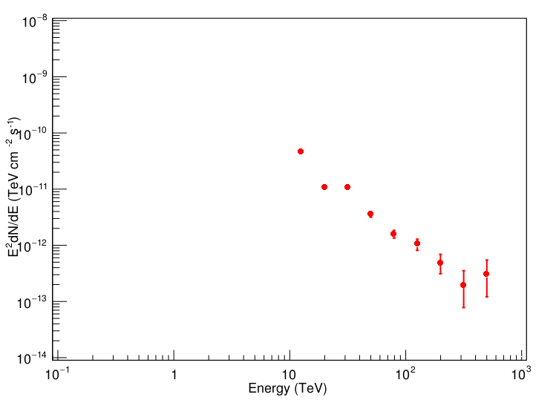

J1838-0603
ra:279.68 dec:-6.06
E:12.6 flux:2.89e-13 + 2.62e-14 - 2.62e-14
E:20.0 flux:2.73e-14 + 2.25e-15 - 2.25e-15
E:31.6 flux:1.06e-14 + 8.78e-16 - 8.78e-16
E:50.1 flux:1.43e-15 + 1.67e-16 - 1.67e-16
E:79.4 flux:2.53e-16 + 3.97e-17 - 3.97e-17
E:125.9 flux:6.62e-17 + 1.50e-17 - 1.50e-17
E:199.5 flux:1.23e-17 + 5.08e-18 - 4.48e-18
E:316.2 flux:1.96e-18 + 1.57e-18 - 1.18e-18
E:501.2 flux:1.21e-18 + 9.68e-19 - 7.26e-19
E:25118.9 flux:4.80e-24 + 5.06e-24 - 3.29e-24
alpha:1.13e-14 (+-)1.61647e-15
beta:-3.09 (+-)0.0685193
$$f\left(E\right)=\left(1.13±0.1616\right)×{10}^{−14}∙{\left(\frac{E}{10TeV}\right)}^{−3.09±0.0685}$$

Slide 12
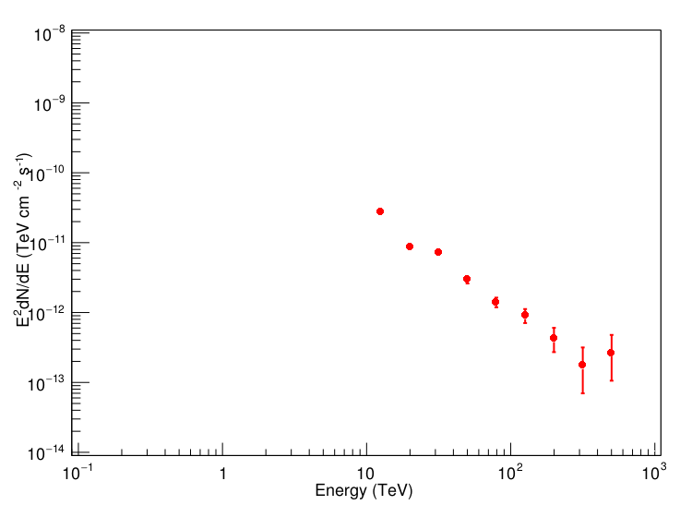

J1843-0341
ra:280.97 dec:-3.70
E:12.6 flux:1.74e-13 + 1.58e-14 - 1.58e-14
E:20.0 flux:2.15e-14 + 1.78e-15 - 1.78e-15
E:31.6 flux:7.32e-15 + 6.07e-16 - 6.07e-16
E:50.1 flux:1.17e-15 + 1.37e-16 - 1.37e-16
E:79.4 flux:2.24e-16 + 3.52e-17 - 3.52e-17
E:125.9 flux:5.77e-17 + 1.31e-17 - 1.31e-17
E:199.5 flux:1.07e-17 + 4.44e-18 - 3.91e-18
E:316.2 flux:1.75e-18 + 1.41e-18 - 1.06e-18
E:501.2 flux:1.06e-18 + 8.47e-19 - 6.35e-19
E:25118.9 flux:4.41e-24 + 4.65e-24 - 3.02e-24
alpha:1.13e-14 (+-)1.22145e-15
beta:-3.09 (+-)0.0662084
$$f\left(E\right)=\left(1.13±0.1221\right)×{10}^{−14}∙{\left(\frac{E}{10TeV}\right)}^{−3.09±0.0662}$$

Slide 13


J1848-0149
ra:282.12 dec:-1.83
E:12.6 flux:1.21e-13 + 1.10e-14 - 1.10e-14
E:20.0 flux:1.80e-14 + 1.48e-15 - 1.48e-15
E:31.6 flux:5.60e-15 + 4.64e-16 - 4.64e-16
E:50.1 flux:9.96e-16 + 1.16e-16 - 1.16e-16
E:79.4 flux:2.03e-16 + 3.19e-17 - 3.19e-17
E:125.9 flux:5.06e-17 + 1.14e-17 - 1.14e-17
E:199.5 flux:9.83e-18 + 4.06e-18 - 3.58e-18
E:316.2 flux:1.61e-18 + 1.29e-18 - 9.69e-19
E:501.2 flux:9.89e-19 + 7.93e-19 - 5.95e-19
E:25118.9 flux:3.91e-24 + 4.12e-24 - 2.68e-24
alpha:1.13e-14 (+-)9.76415e-16
beta:-3.09 (+-)0.0643054
$$f\left(E\right)=\left(1.13±0.0976\right)×{10}^{−14}∙{\left(\frac{E}{10TeV}\right)}^{−3.09±0.0643}$$

Slide 14


J1850-0005
ra:282.55 dec:-0.09
E:12.6 flux:9.75e-14 + 8.87e-15 - 8.87e-15
E:20.0 flux:1.63e-14 + 1.34e-15 - 1.34e-15
E:31.6 flux:4.75e-15 + 3.94e-16 - 3.94e-16
E:50.1 flux:9.02e-16 + 1.05e-16 - 1.05e-16
E:79.4 flux:1.84e-16 + 2.89e-17 - 2.89e-17
E:125.9 flux:4.73e-17 + 1.07e-17 - 1.07e-17
E:199.5 flux:9.42e-18 + 3.89e-18 - 3.43e-18
E:316.2 flux:1.52e-18 + 1.22e-18 - 9.17e-19
E:501.2 flux:8.75e-19 + 7.02e-19 - 5.26e-19
E:25118.9 flux:3.52e-24 + 3.72e-24 - 2.41e-24
alpha:1.13e-14 (+-)8.49059e-16
beta:-3.09 (+-)0.0630793
$$f\left(E\right)=\left(1.13±0.0849\right)×{10}^{−14}∙{\left(\frac{E}{10TeV}\right)}^{−3.09±0.0631}$$

Slide 15


J1857+0214
ra:284.28 dec:2.23
E:12.6 flux:7.59e-14 + 6.90e-15 - 6.90e-15
E:20.0 flux:1.42e-14 + 1.18e-15 - 1.18e-15
E:31.6 flux:4.02e-15 + 3.34e-16 - 3.34e-16
E:50.1 flux:7.95e-16 + 9.28e-17 - 9.28e-17
E:79.4 flux:1.69e-16 + 2.66e-17 - 2.66e-17
E:125.9 flux:4.45e-17 + 1.01e-17 - 1.01e-17
E:199.5 flux:8.50e-18 + 3.51e-18 - 3.10e-18
E:316.2 flux:1.44e-18 + 1.16e-18 - 8.69e-19
E:501.2 flux:8.54e-19 + 6.85e-19 - 5.14e-19
E:25118.9 flux:3.45e-24 + 3.64e-24 - 2.36e-24
alpha:1.13e-14 (+-)7.20791e-16
beta:-3.09 (+-)0.0615608
$$f\left(E\right)=\left(1.13±0.0721\right)×{10}^{−14}∙{\left(\frac{E}{10TeV}\right)}^{−3.09±0.0616}$$

Slide 16


J1908+0617
ra:287.01 dec:6.29
E:12.6 flux:5.48e-14 + 4.98e-15 - 4.98e-15
E:20.0 flux:1.18e-14 + 9.77e-16 - 9.77e-16
E:31.6 flux:3.13e-15 + 2.60e-16 - 2.60e-16
E:50.1 flux:6.68e-16 + 7.80e-17 - 7.80e-17
E:79.4 flux:1.47e-16 + 2.32e-17 - 2.32e-17
E:125.9 flux:3.81e-17 + 8.64e-18 - 8.64e-18
E:199.5 flux:7.56e-18 + 3.13e-18 - 2.76e-18
E:316.2 flux:1.34e-18 + 1.08e-18 - 8.09e-19
E:501.2 flux:7.53e-19 + 6.04e-19 - 4.53e-19
E:25118.9 flux:3.18e-24 + 3.35e-24 - 2.18e-24
alpha:1.13e-14 (+-)5.69255e-16
beta:-3.09 (+-)0.0598165
$$f\left(E\right)=\left(1.13±0.0569\right)×{10}^{−14}∙{\left(\frac{E}{10TeV}\right)}^{−3.09±0.0598}$$

Slide 17
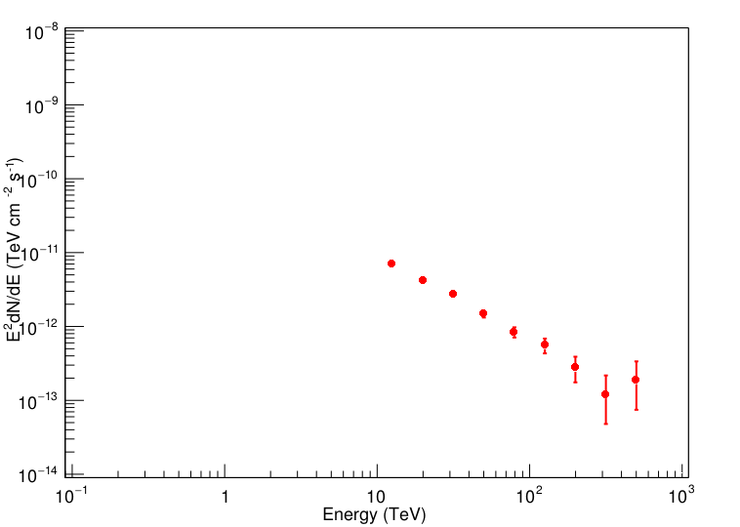

J1912+1008
ra:288.05 dec:10.14
E:12.6 flux:4.38e-14 + 3.98e-15 - 3.98e-15
E:20.0 flux:1.04e-14 + 8.57e-16 - 8.57e-16
E:31.6 flux:2.73e-15 + 2.26e-16 - 2.26e-16
E:50.1 flux:5.96e-16 + 6.95e-17 - 6.95e-17
E:79.4 flux:1.33e-16 + 2.10e-17 - 2.10e-17
E:125.9 flux:3.53e-17 + 7.99e-18 - 7.99e-18
E:199.5 flux:6.93e-18 + 2.86e-18 - 2.52e-18
E:316.2 flux:1.20e-18 + 9.69e-19 - 7.25e-19
E:501.2 flux:7.44e-19 + 5.97e-19 - 4.48e-19
E:25118.9 flux:3.04e-24 + 3.21e-24 - 2.08e-24
alpha:1.13e-14 (+-)4.82192e-16
beta:-3.09 (+-)0.0575632
$$f\left(E\right)=\left(1.13±0.0482\right)×{10}^{−14}∙{\left(\frac{E}{10TeV}\right)}^{−3.09±0.0576}$$

Slide 18


J1928+1804
ra:292.07 dec:18.07
E:12.6 flux:3.41e-14 + 3.10e-15 - 3.10e-15
E:20.0 flux:8.73e-15 + 7.21e-16 - 7.21e-16
E:31.6 flux:2.23e-15 + 1.85e-16 - 1.85e-16
E:50.1 flux:5.08e-16 + 5.93e-17 - 5.93e-17
E:79.4 flux:1.15e-16 + 1.80e-17 - 1.80e-17
E:125.9 flux:3.08e-17 + 6.96e-18 - 6.96e-18
E:199.5 flux:6.13e-18 + 2.53e-18 - 2.23e-18
E:316.2 flux:1.08e-18 + 8.70e-19 - 6.51e-19
E:501.2 flux:6.38e-19 + 5.12e-19 - 3.84e-19
E:25118.9 flux:2.80e-24 + 2.95e-24 - 1.92e-24
alpha:1.13e-14 (+-)3.9429e-16
beta:-3.09 (+-)0.0568028
$$f\left(E\right)=\left(1.13±0.0394\right)×{10}^{−14}∙{\left(\frac{E}{10TeV}\right)}^{−3.09±0.0568}$$

Slide 19
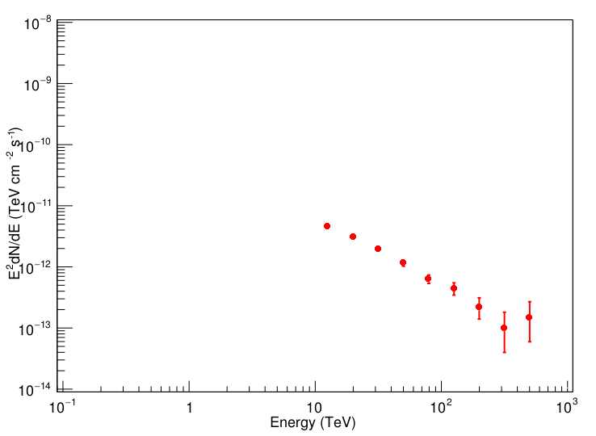

J1956+2854
ra:299.09 dec:28.91
E:12.6 flux:2.91e-14 + 2.65e-15 - 2.65e-15
E:20.0 flux:7.74e-15 + 6.39e-16 - 6.39e-16
E:31.6 flux:1.98e-15 + 1.64e-16 - 1.64e-16
E:50.1 flux:4.62e-16 + 5.39e-17 - 5.39e-17
E:79.4 flux:1.01e-16 + 1.59e-17 - 1.59e-17
E:125.9 flux:2.82e-17 + 6.38e-18 - 6.38e-18
E:199.5 flux:5.53e-18 + 2.29e-18 - 2.02e-18
E:316.2 flux:1.00e-18 + 8.06e-19 - 6.03e-19
E:501.2 flux:5.95e-19 + 4.77e-19 - 3.57e-19
E:25118.9 flux:2.52e-24 + 2.66e-24 - 1.73e-24
alpha:1.13e-14 (+-)3.44461e-16
beta:-3.09 (+-)0.0556119
$$f\left(E\right)=\left(1.13±0.0344\right)×{10}^{−14}∙{\left(\frac{E}{10TeV}\right)}^{−3.09±0.0556}$$

Slide 20
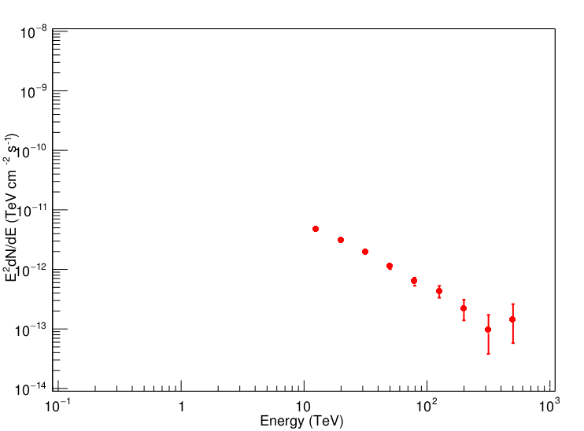

J2019+3649
ra:304.86 dec:36.83
E:12.6 flux:2.96e-14 + 2.69e-15 - 2.69e-15
E:20.0 flux:7.69e-15 + 6.35e-16 - 6.35e-16
E:31.6 flux:1.97e-15 + 1.64e-16 - 1.64e-16
E:50.1 flux:4.55e-16 + 5.31e-17 - 5.31e-17
E:79.4 flux:9.98e-17 + 1.57e-17 - 1.57e-17
E:125.9 flux:2.72e-17 + 6.17e-18 - 6.17e-18
E:199.5 flux:5.52e-18 + 2.28e-18 - 2.01e-18
E:316.2 flux:9.56e-19 + 7.69e-19 - 5.76e-19
E:501.2 flux:5.77e-19 + 4.63e-19 - 3.47e-19
E:25118.9 flux:2.53e-24 + 2.66e-24 - 1.73e-24
alpha:1.13e-14 (+-)3.45794e-16
beta:-3.09 (+-)0.0562759
$$f\left(E\right)=\left(1.13±0.0346\right)×{10}^{−14}∙{\left(\frac{E}{10TeV}\right)}^{−3.09±0.0563}$$

Slide 21


J2031+4120
ra:307.86 dec:41.33
E:12.6 flux:3.15e-14 + 2.87e-15 - 2.87e-15
E:20.0 flux:7.97e-15 + 6.58e-16 - 6.58e-16
E:31.6 flux:2.04e-15 + 1.69e-16 - 1.69e-16
E:50.1 flux:4.69e-16 + 5.48e-17 - 5.48e-17
E:79.4 flux:1.04e-16 + 1.63e-17 - 1.63e-17
E:125.9 flux:2.81e-17 + 6.36e-18 - 6.36e-18
E:199.5 flux:5.62e-18 + 2.32e-18 - 2.05e-18
E:316.2 flux:9.53e-19 + 7.67e-19 - 5.74e-19
E:501.2 flux:5.78e-19 + 4.64e-19 - 3.48e-19
E:25118.9 flux:2.43e-24 + 2.56e-24 - 1.66e-24
alpha:1.13e-14 (+-)3.6233e-16
beta:-3.09 (+-)0.0567024
$$f\left(E\right)=\left(1.13±0.0362\right)×{10}^{−14}∙{\left(\frac{E}{10TeV}\right)}^{−3.09±0.0567}$$

Slide 22
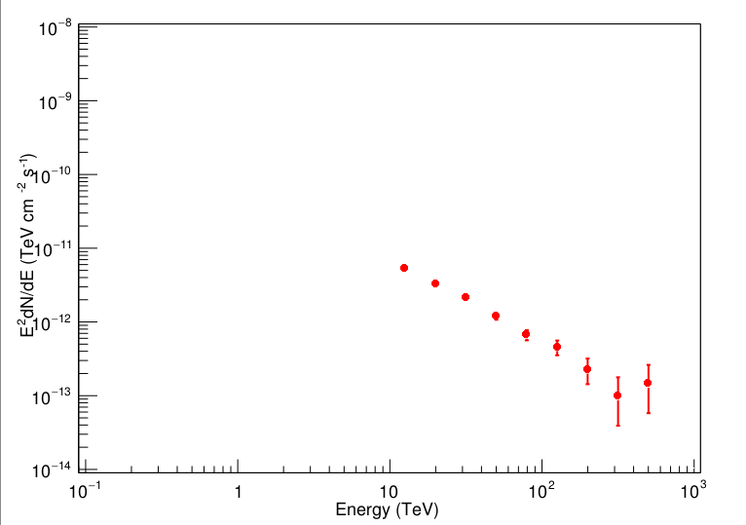

J2045+4421
ra:311.48 dec:44.36
E:12.6 flux:3.37e-14 + 3.06e-15 - 3.06e-15
E:20.0 flux:8.22e-15 + 6.79e-16 - 6.79e-16
E:31.6 flux:2.11e-15 + 1.75e-16 - 1.75e-16
E:50.1 flux:4.83e-16 + 5.64e-17 - 5.64e-17
E:79.4 flux:1.06e-16 + 1.67e-17 - 1.67e-17
E:125.9 flux:2.88e-17 + 6.52e-18 - 6.52e-18
E:199.5 flux:5.66e-18 + 2.34e-18 - 2.06e-18
E:316.2 flux:9.84e-19 + 7.92e-19 - 5.93e-19
E:501.2 flux:5.78e-19 + 4.64e-19 - 3.48e-19
E:25118.9 flux:2.46e-24 + 2.59e-24 - 1.69e-24
alpha:1.13e-14 (+-)3.78704e-16
beta:-3.09 (+-)0.0574849
$$f\left(E\right)=\left(1.13±0.0379\right)×{10}^{−14}∙{\left(\frac{E}{10TeV}\right)}^{−3.09±0.0567}$$

Slide 23
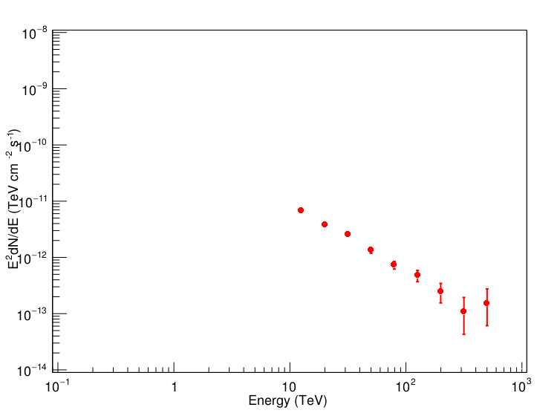

J2109+5155
ra:317.38 dec:51.92
E:12.6 flux:4.36e-14 + 3.96e-15 - 3.96e-15
E:20.0 flux:9.51e-15 + 7.85e-16 - 7.85e-16
E:31.6 flux:2.53e-15 + 2.10e-16 - 2.10e-16
E:50.1 flux:5.33e-16 + 6.22e-17 - 6.22e-17
E:79.4 flux:1.17e-16 + 1.83e-17 - 1.83e-17
E:125.9 flux:3.02e-17 + 6.85e-18 - 6.85e-18
E:199.5 flux:6.14e-18 + 2.54e-18 - 2.24e-18
E:316.2 flux:1.08e-18 + 8.65e-19 - 6.48e-19
E:501.2 flux:6.09e-19 + 4.88e-19 - 3.66e-19
E:25118.9 flux:2.56e-24 + 2.70e-24 - 1.75e-24
alpha:1.13e-14 (+-)4.55784e-16
beta:-3.09 (+-)0.0594378
$$f\left(E\right)=\left(1.13±0.0456\right)×{10}^{−14}∙{\left(\frac{E}{10TeV}\right)}^{−3.09±0.0594}$$

Slide 24


J2159+5637
ra:329.93 dec:56.62
E:12.6 flux:6.01e-14 + 5.46e-15 - 5.46e-15
E:20.0 flux:1.12e-14 + 9.21e-16 - 9.21e-16
E:31.6 flux:3.21e-15 + 2.66e-16 - 2.66e-16
E:50.1 flux:6.17e-16 + 7.20e-17 - 7.20e-17
E:79.4 flux:1.30e-16 + 2.05e-17 - 2.05e-17
E:125.9 flux:3.42e-17 + 7.74e-18 - 7.74e-18
E:199.5 flux:6.68e-18 + 2.76e-18 - 2.43e-18
E:316.2 flux:1.12e-18 + 9.00e-19 - 6.74e-19
E:501.2 flux:6.51e-19 + 5.22e-19 - 3.91e-19
E:25118.9 flux:2.73e-24 + 2.87e-24 - 1.87e-24
alpha:1.13e-14 (+-)5.66301e-16
beta:-3.09 (+-)0.0615315
$$f\left(E\right)=\left(1.13±0.0566\right)×{10}^{−14}∙{\left(\frac{E}{10TeV}\right)}^{−3.09±0.0615}$$

Slide 25


J2228+6054
ra:337.20 dec:60.90
E:12.6 flux:9.56e-14 + 8.69e-15 - 8.69e-15
E:20.0 flux:1.37e-14 + 1.13e-15 - 1.13e-15
E:31.6 flux:4.39e-15 + 3.64e-16 - 3.64e-16
E:50.1 flux:7.46e-16 + 8.70e-17 - 8.70e-17
E:79.4 flux:1.50e-16 + 2.35e-17 - 2.35e-17
E:125.9 flux:3.80e-17 + 8.60e-18 - 8.60e-18
E:199.5 flux:7.26e-18 + 3.00e-18 - 2.65e-18
E:316.2 flux:1.15e-18 + 9.23e-19 - 6.91e-19
E:501.2 flux:7.17e-19 + 5.75e-19 - 4.31e-19
E:25118.9 flux:2.82e-24 + 2.97e-24 - 1.93e-24
alpha:1.13e-14 (+-)7.50819e-16
beta:-3.09 (+-)0.0647975
$$f\left(E\right)=\left(1.13±0.0751\right)×{10}^{−14}∙{\left(\frac{E}{10TeV}\right)}^{−3.09±0.0645}$$

Slide 26
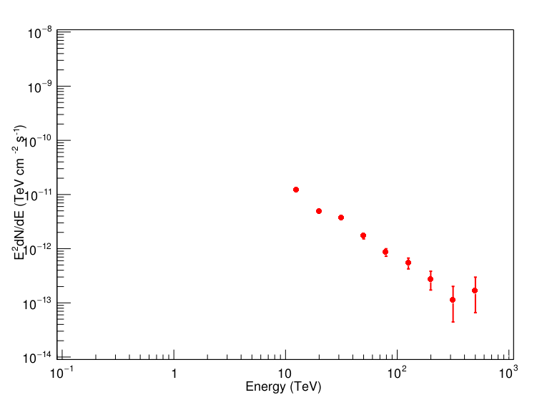

J2234+5854
ra:338.62 dec:58.92
E:12.6 flux:7.60e-14 + 6.91e-15 - 6.91e-15
E:20.0 flux:1.22e-14 + 1.00e-15 - 1.00e-15
E:31.6 flux:3.73e-15 + 3.09e-16 - 3.09e-16
E:50.1 flux:6.84e-16 + 7.98e-17 - 7.98e-17
E:79.4 flux:1.36e-16 + 2.15e-17 - 2.15e-17
E:125.9 flux:3.45e-17 + 7.81e-18 - 7.81e-18
E:199.5 flux:6.82e-18 + 2.82e-18 - 2.49e-18
E:316.2 flux:1.12e-18 + 8.99e-19 - 6.73e-19
E:501.2 flux:6.59e-19 + 5.28e-19 - 3.96e-19
E:25118.9 flux:2.67e-24 + 2.82e-24 - 1.83e-24
alpha:1.13e-14 (+-)6.45168e-16
beta:-3.09 (+-)0.0628098
$$f\left(E\right)=\left(1.13±0.0645\right)×{10}^{−14}∙{\left(\frac{E}{10TeV}\right)}^{−3.09±0.0628}$$

